Slide 1


Air Force Institute of Technology
NENG 791 – Proliferation of Weapons of Mass Destruction
Plutonium Production
LTC Buck O’Day
E d u c a t i n g t h e W o r l d ’s B e s t M i l i t a r y
Notes:
Note, this will be a rather “short” lesson and I will move on to the “Signatures of SNM” block of instruction.

Slide 2
Outline: Overview of Plutonium Production
Where does Plutonium come from?
Plutonium isotopic ratios
Plutonium production heuristics
Relevant plutonium isotopes
Production of WGPu
Plutonium production in reactors overview
Plutonium reprocessing: what, why, and so what?
PUREX overview
Notes:
The simple, short answers
(1) From breeding in a reactor
(2) Determine whether material is WG or not; impacts its usefulness for applications; provides insights into the history of the material
(3) We want “short” residence times for WGU.
(4) 239Pu for fuel and weapons, 240Pu decays via alpha and spontaneous fission, 241Pu becay decays and 241Am has a strong gamma line which is useful for detection purposes.
(5) Must to some kind of reprocessing.
(6) Presence (sometimes) and Isotopics abundances change with fuel history
(7) see the slide
(8) see the hidden slides
Can someone explain to me how 239Pu and other isotopes are created?

Slide 3
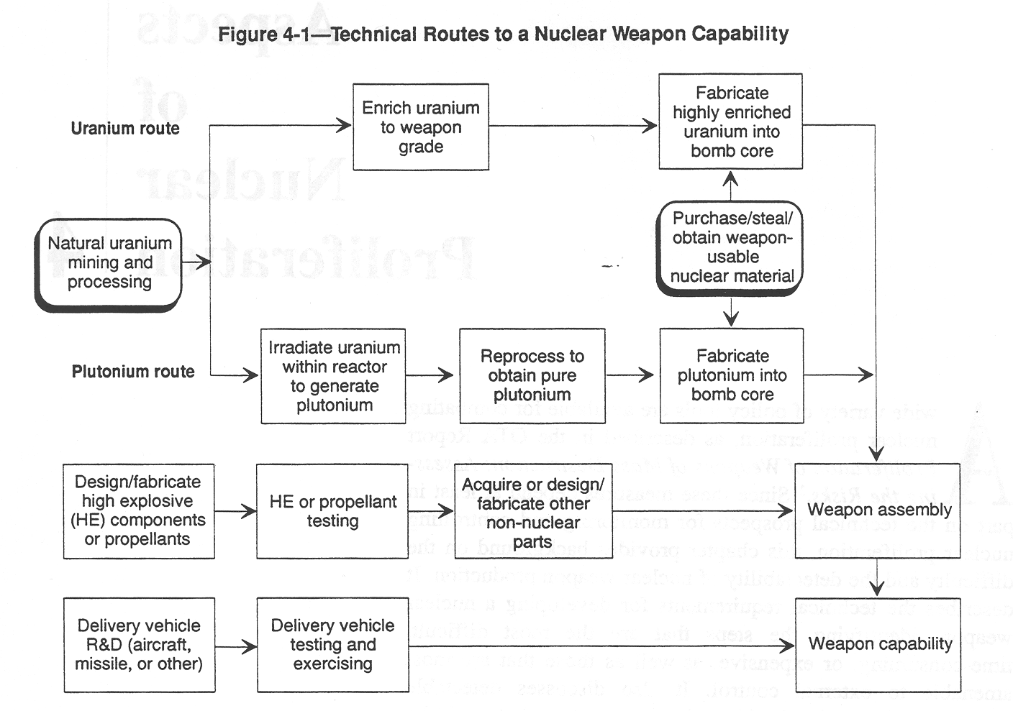
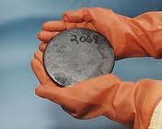
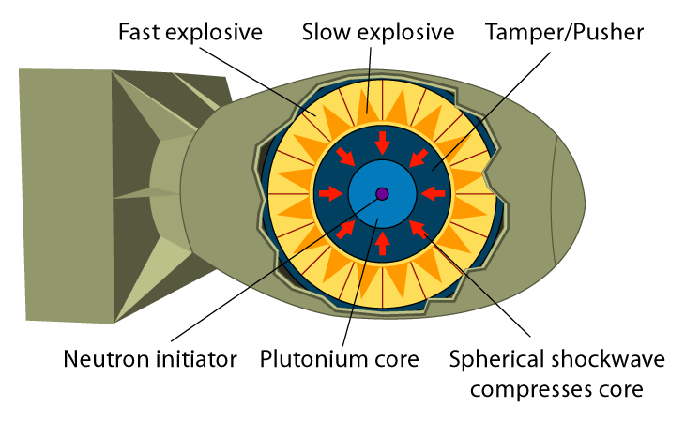
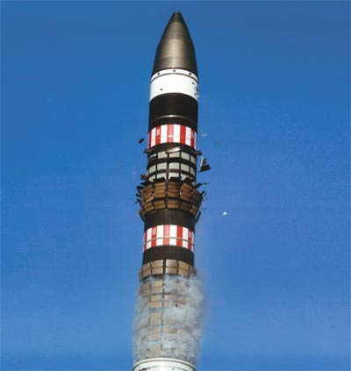
Technical Routes to a Nuclear Weapon
1
2
3
Major Steps
Obtain special nuclear material
Integrate high explosive components
Integrate delivery system
Notes:
You already should have a good understanding of the technical routes to a nuclear weapon.
And, of course, you KNOW the three major steps.
We see that we get Pu from irradiation of U238 in a reactor.
This lesson concentrates on the Plutonium route.

Slide 4
Plutonium Isotope Production (1 of 3)
Z=94
²³⁹Pu
²⁴⁰Pu
²⁴¹Pu
²⁴²Pu
2.4 days
neutron induced fission
Z=93
²³⁹Np
beta decay
24 min
neutron absorption
Z=92
²³⁸U
²³⁹U
N=145
N=146
N=147
N=148
Notes:
The graphic you see here is basically the nuclear view of how we produce Pu.
In nature, it does not exist in any appreciable amount.
While it is almost certainly produced with other heavy materials in supernovas, its half-life is way too short for it to still be in the material on earth
Thus, the presence of Pu means that it was once 238U that was in a reactor.
Power reactor fuel usually has U enriched in 235U to a few percent. The remainder is mostly 238U which is fertile.
At 3%, we are talking about a ratio of about 33 238U nuclei to each 235U. So even thought 238U has a smaller cross section, we can still produce Pu from (n,g) reactions (with subsequent beta decays) and higher isotopes from other (n,g) reactions.
If the reactor runs for long enough, enough 239Pu (fissile) is produced that must be accounted for (to maintain control of the reactor).
With short irradiation times, relatively pure (meaning not many higher isotopes) 239Pu is formed.
How does longer residence time in the reactor (greater fuel burnup) impact the undesirable higher Pu isotope content?
Can someone explain to me the cost / benefit of irradiating fuel to create 239Pu?

Slide 5
Plutonium Isotope Production (2 of 3)
Notes:
If you wanted to, you could work out the equations to very deliberately calculate the amount of Pu239 produced. You would also do the same for any other isotopes.
The equations used to do this are known as the Bateman equations.
Obviously, with many different reactions, decays, and isotopes, you probably want to go the route of using a computer program for any non-trivial problem.
The key to understanding (and, in fact, to deriving) the Bateman equations is to think about what is physically happening.
For any isotope, the rate of change is the difference between the rate of creation and the rate of loss.
Creation can be from nuclear reactions (e.g. (n,g)) or from parent decay to the isotope (e.g. alpha or beta decay)
Loss can be from decay (via particle emission or other decay mode) or from nuclear reactions (e.g. another (n,g))
The terms should make sense to you. For example, for the rate of change in the number of 239U isotopes:
The first term describes 238U(n,gamma)239U* which is a source for 239U. This depends on the number of 238U present, the absorption (n,g) cross section, and the neutron flux.
The second term describes 239U(n,g)240U* which is a loss mechanism for 239U.
The third term describes the loss of 239U through decay mechanisms.

Slide 6
Plutonium Isotope Production (3 of 3)
The differential equations may be re-written in general form
Multiplying each side by the integrating factor and integrating
General solution for number of nuclei of an arbitrary isotope in the plutonium production chain at time t
Notes:
I don’t expect you to memorize a bunch of differential equations but you could easily derive these from your knowledge of what is happening in the reactor and a little bit of math.

Slide 7
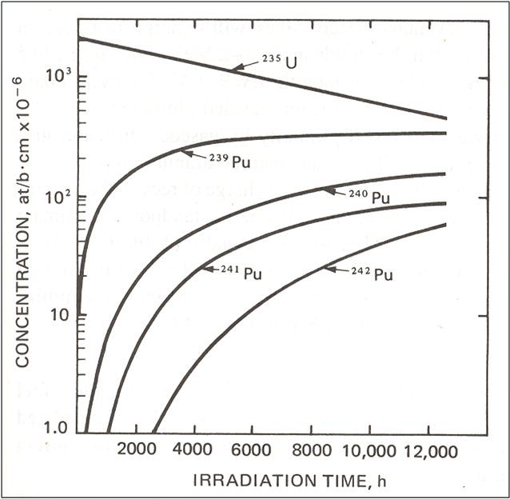
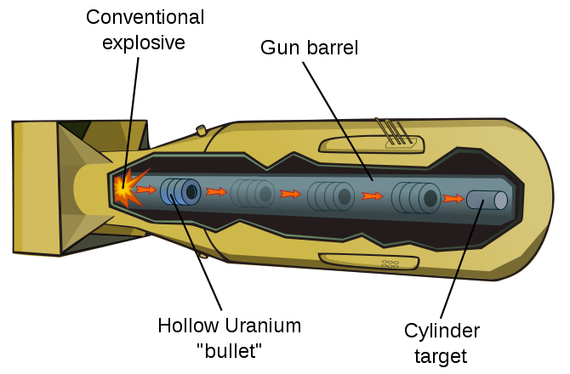
Plutonium Isotopic Ratios
Spontaneous fission
8
²⁴⁰Pu: 450 / kg-msec
At 1000 m/sec, gun-type assembly using Pu could generate 100s to 1000s of spontaneous fission neutrons
Reactor grade: > 19%
Fuel grade: 7% – 19%
Weapon grade: < 7% to left of this line
Notes:
Key points from this slide are that:
(1) You start producing 239Pu as soon as you turn on your reactor.
(2) The longer you operate (the greater the fuel burnup) the more of the undesirable higher Pu isotopes you produce.
(3) There is a cost (higher Pu isotope production) associated with getting more 239Pu out. At some point, the cost is no longer worth the added benefit.
Which Pu isotopes decay by spontaneous fission?
All of them do but the main one of concern is 240Pu
Which Pu isotope has a daughter product that is a very intense gamma emitter that comes in handy for detection purposes?
241Pu’s daughter—241Am
Which Pu isotope decays via both SF and alpha decay?
Again, 240Pu is the main one of concern

Slide 8
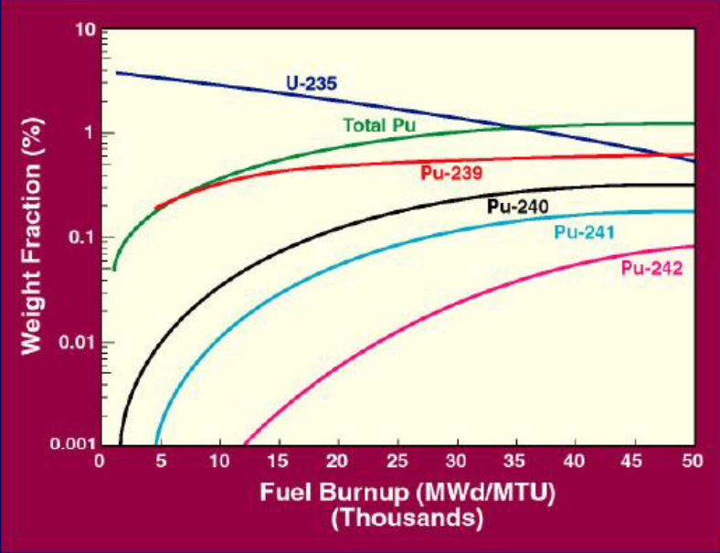
Pu Isotopes as a Function of Burnup
Notes:
Here is a different way of looking at what we just saw.
Basically, the higher the Burnup, the more higher level Pu isotopes you produce.
Thus, you really want to limit the burnup of your fuel if you are trying to produce Pu for a weapon.
As you can imagine, you can tell a lot about the history of the fuel by looking at the isotopics.

Slide 9
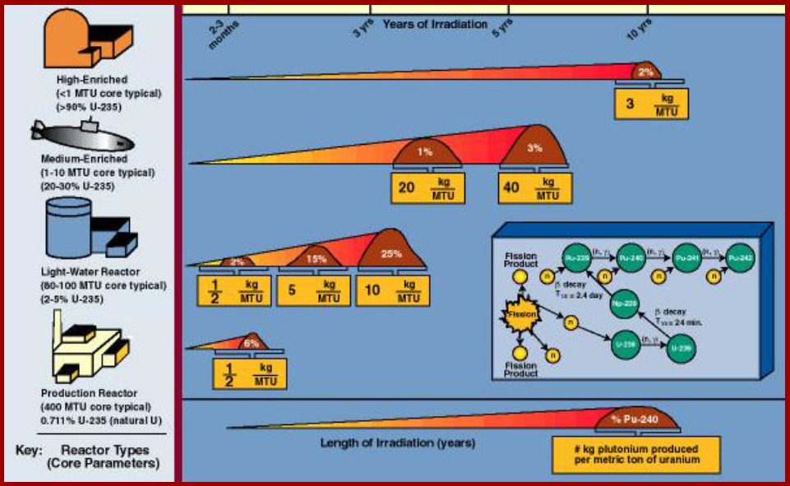
Pu Production Heuristics
Notes:
There are some neat rules of thumb on this slide.
Of course, this doesn’t tell you the 239Pu content, just the total. You’d still need to consider the isotopics.

Slide 10
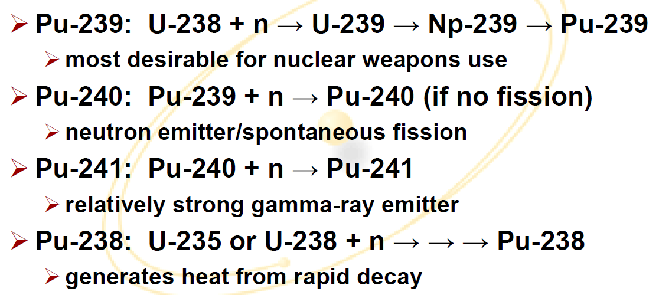
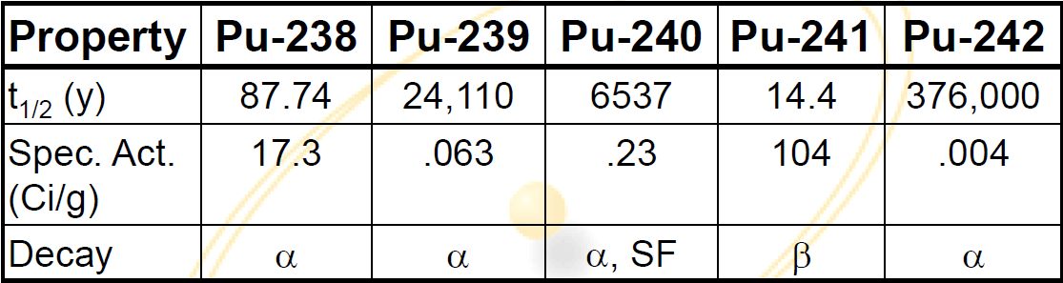
Relevant Plutonium Isotopes
Notes:
Key points form this slide:
You should know how we get the different isotopes.
Notice the half-lives and activities of the Pu isotopes. If you are trying to make a bomb, 239Pu is preferable because it has a (relatively) long half-life and a low specific activity.
You should note that 241Pu decays into 241Am which is an intense gamma emitter. This comes in handy for detection purposes.
Most even Pu isotopes (238, 240, etc) also decay by spontaneous fission
If we want to get WGPu, what is the typical residence time? I.e. how long would we leave the fuel in a reactor?
Weeks to month or you start breeding too many of the higher isotopes

Slide 11
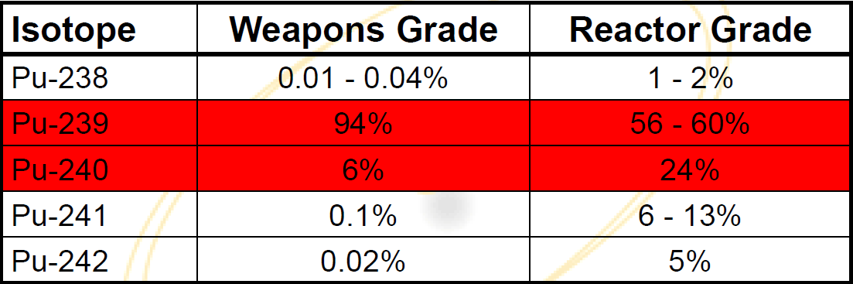
Production of WGPu
At least 94% ²³⁹Pu
Typically generate in weeks to months in a reactor
Frequent refueling required for optimum production
Separating isotopes is a nontrivial effort
Typically affects power production
Comparison of weapons and reactor grade isotopics:
WGPu < 7% ²⁴⁰Pu
RGPu > 18% ²⁴⁰Pu
Notes:
Residence times for producing WGPu is order of weeks to months. Of course, this depends on how your are operating your reactor.
From a proliferation standpoint, we like for operators to be run for a very long time so that you end up with RGPu, which is not as useful for weapon development.

Slide 12
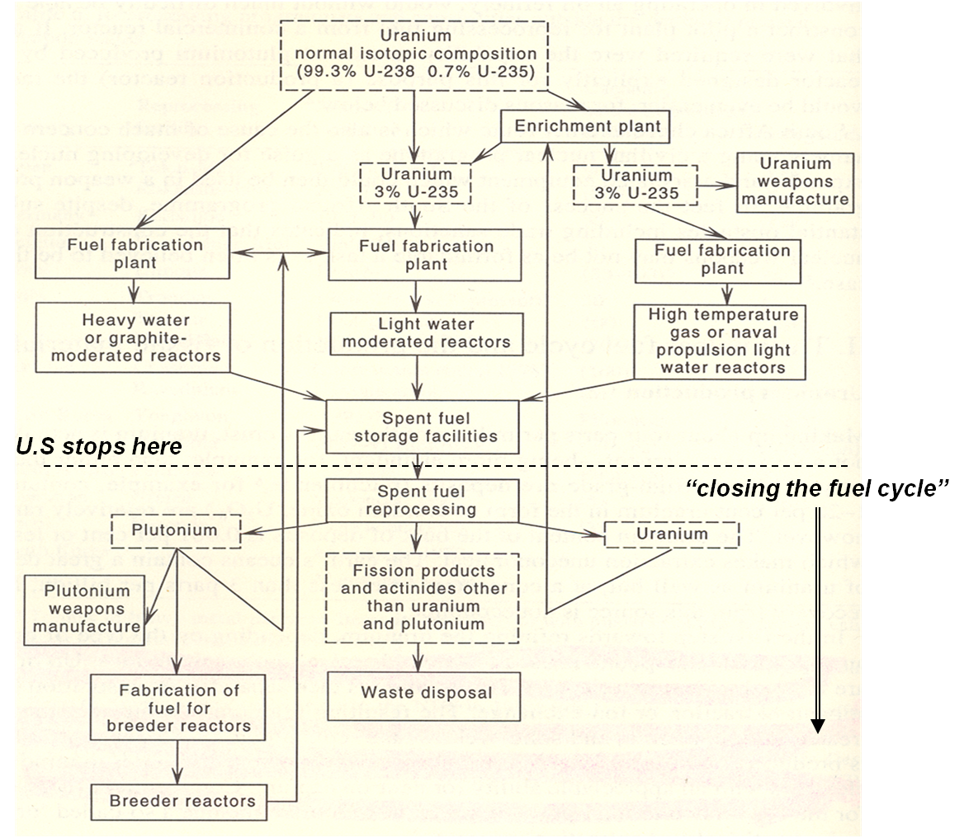
Plutonium Production in Reactors Overview
Notes:
On the subsequent slides (which are hidden) there are some graphics of reactors. Those will be covered in NENG 720 so I won’t address them in class.
However, we should discuss overall plutonium production in reactors and we can use this slide to do so.
To get Pu, you must “breed” it from 238U, which happens in reactors using natural U (CANDU) and 3-5% enriched U (LWRs).
When you reprocess the fuel (covered in a few slides) you can separate out the Pu and use it to fabricate fuel or a weapon (which is a non-trivial process).
We don’t like folks to reprocess (unless they are our close allies) because of the proliferation risk.
We don’t like folks to use CANDU reactors (unless they are our allies) because you can refuel them online which makes Pu production that much easier.

Slide 13
Generation I Reactor Plutonium Production
Schematic of X-10 reactor at ORNL
Slug pushers at X-10

Slide 14
Generation II Reactor Plutonium Production (1 of 2)
Nearly all of the 400+ worldwide reactor systems are Generation II
PWR
Two loop system
High pressure in reactor core to maintain water below boiling point
Requires shut down to remove fuel
BWR
Single loop system
Coolant permitted to boil in reactor core
Also requires shut down to remove fuel
Pressurized water reactor (PWR) schematic
Boiling water reactor (BWR) schematic

Slide 15
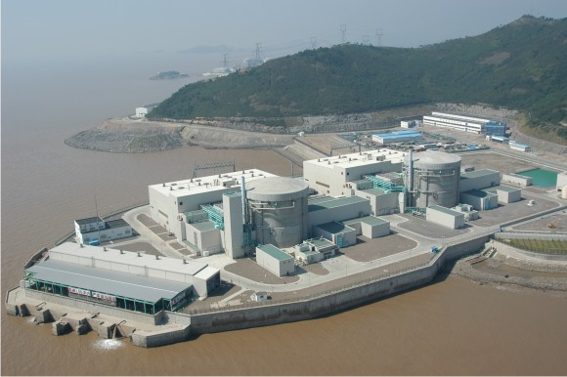
Generation II Reactor Plutonium Production (2 of 2)
Natural uranium
D₂O serves as both moderator and coolant
Pressurized two loop
Continuous refueling
Burn-up less than LEU reactors
Comparable ²³⁹Pu production to LEU reactors
Lack of ²³⁵U
More relative neutron absorption by ²³⁸U (producing Pu).
CANada Deuterium Uranium (CANDU) Reactor
Notes:
CANDU reactors can use natural U as fuel because as the D2O moderates the neutrons, it does not absorb as many as H2O.
Natural U can be used because the D2O doesn’t absorb as many neutrons as H2O.

Slide 16
Generation III Reactor Systems
Generation III
Advanced Boiling Water Reactor (ABWR) – GE
Advanced Pressurized Water Reactor (APWR) – Mitsubishi
Enhanced CANDU 6 (EC-6) – Atomic Energy of Canada
VVER-1000 (A-PWR) – Russia
AP600 (Advanced PWR now abandoned in favor of AP 1000 below)
Generation III+
Advanced CANDU (ACR 1000)
AP1000
European Pressurized Reactor (EPR)
Economic Simplified Boiling Water Reactor (ESBWR)
APR-1400 (advanced PWR chosen by Korea)
VVER-1200
EU-ABWR ( increased power and EU safety standards
Increased fuel lifetimes and burn up ensure that recovered plutonium is reactor grade, not weapon grade

Slide 17
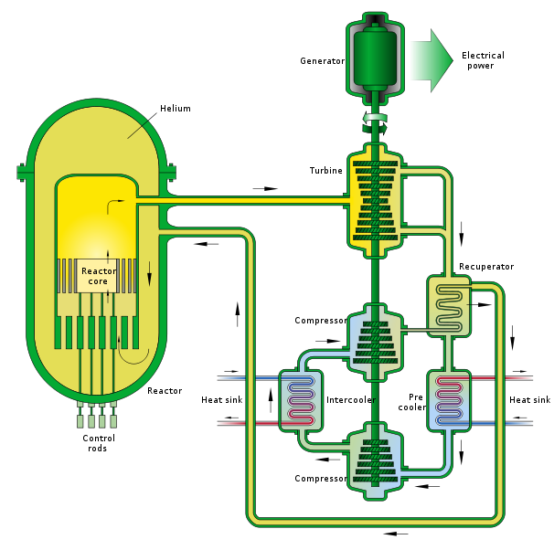
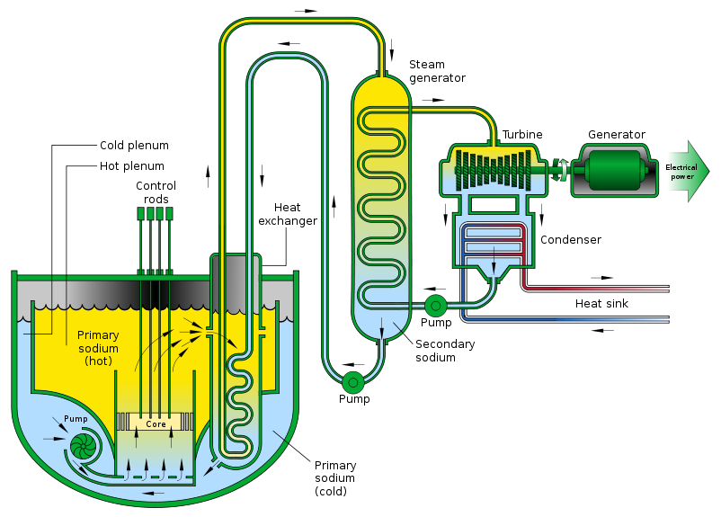
Generation IV Reactor Systems
Gas-cooled fast reactor
Fast neutron spectrum
Helium-cooled reactor
Closed fuel cycle
Sodium-cooled fast reactor
Fast neutron spectrum
Sodium-cooled reactor
Closed fuel cycle

Slide 18
Reprocessing
What?
Chemical separation of irradiated nuclear material to recover fissile (e.g. 239Pu, 233U) and fertile (e.g. 238U, 232Th) elements
Has application in producing power reactor fuel, medical isotopes, removing long-lived actinides for waste disposal but is often thought of in the context of recovering Pu for nuclear weapons
Why?
One of a limited number of ways to acquire fissile material (for military use or reactors)
Elemental separation is “conceptually” easier than isotopic separation
So what?
Chemical processing and elemental separation is less technically challenging than isotope separation but you have to deal with highly radioactive feed and products!
Notes:
This slide covers the essential of fuel reprocessing…
Note that I have stated “conceptually” easier. The activity of the fuel (before it is separated) makes this a very daunting task.

Slide 19
PUREX Overview (1950s)
Expose nuclear material (remove fuel cladding, if necessary)
Dissolve fuel / target in nitric acid
Solvent extraction for initial separation of U and Pu from fission products and each other
Solvent extraction for final separation of Pu from U
Conversion of Pu to oxide or metal
Conversion of U to oxide, hexaflouride, or metal
Waste management / disposal
Notes:
Here are the basic steps.
(1) get the fuel in a form you can use to process it
(2) put it into solution
(3) use the different solubility of Pu and U to separate the fissile/fissionable material from the “other materials.
(4) Separate the Pu from the U
(5a) & (5b) convert your SNM into the form you need
(6) Manage / dispose of the waste products

Slide 20
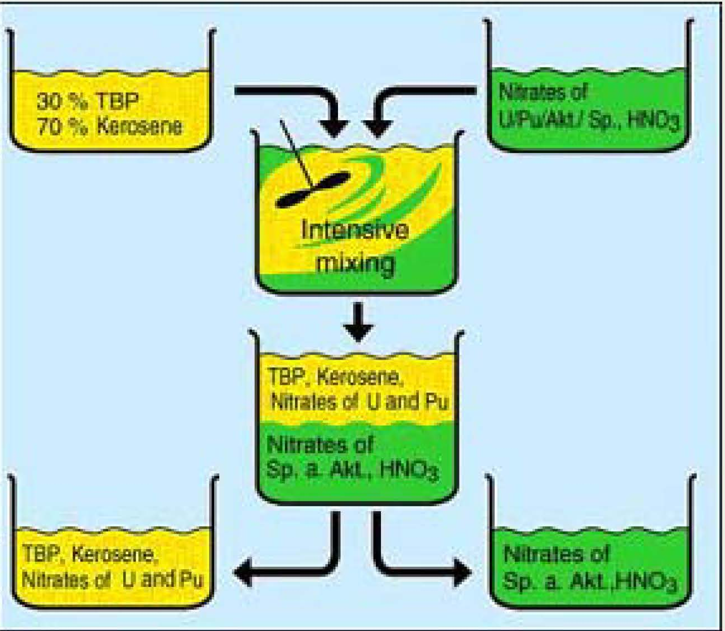
Basic PUREX Process
Notes:
And a graphic.
(TR) In the top right, you’ve dissolved your materials
(TL) In the top left, you’ve got your solution
(MT) In the middle top, you mix them together
(MB) In the middle bottom, you see the U and Pu have been driven into the TBP/kerosene mixture. You allow these to settle and the less dense TBP/Kerosene mixture goes to the top
(BL) & (BR) You separate the two and proceed

Slide 21
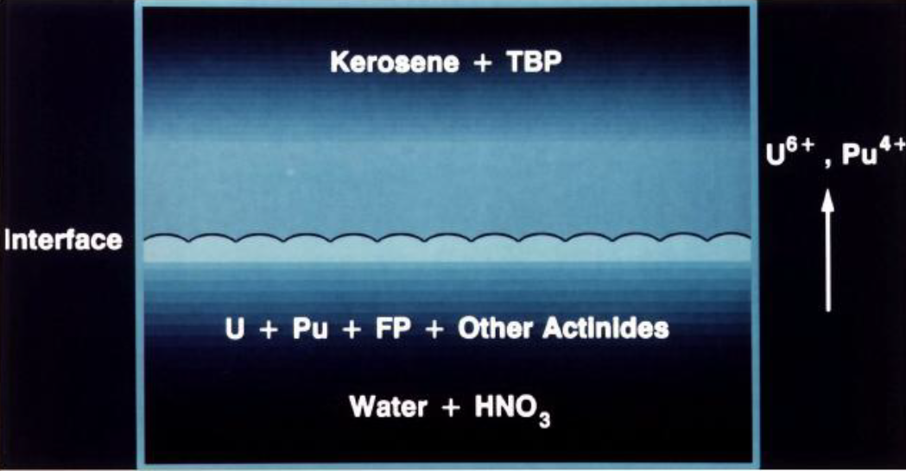
Basic PUREX Process
Notes:
NENG681/CHEM581 explains the transference of the U and Pu into the Kerosene/TBP solution

Slide 22
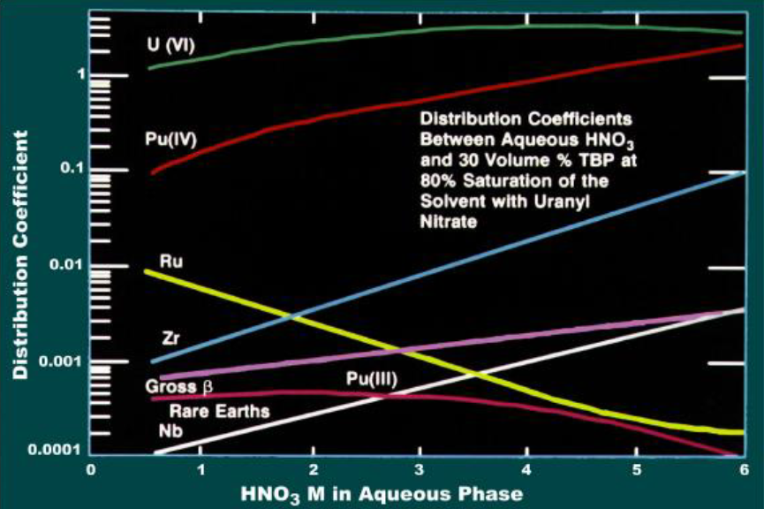
Distribution Coefficients
Notes:
Again, a question for Dr. B

Slide 23
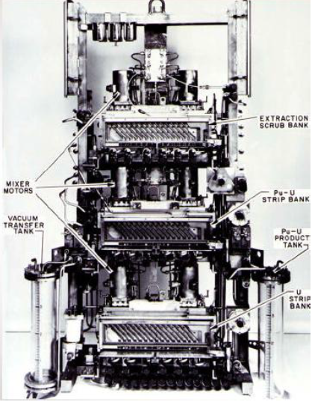
Solvent Extraction Equipment
Mixer-Settlers (oldest technology)
Mix liquids with propeller; gravity separation in a separate chamber
Must be done many times in sequence

Slide 24
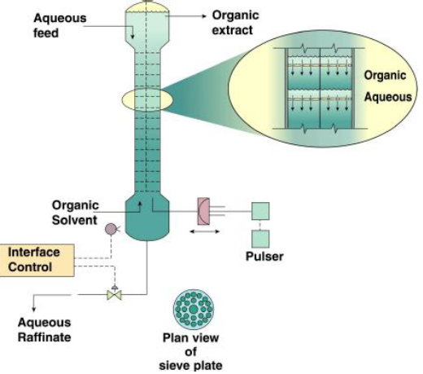
Solvent Extraction Equipment
Pulse Columns
Tall cylindrical columns with perforated axial plates
Heavier aqueous liquid fed at top, lighter TBP / diluents at bottom
Multiple contacting operations in a single column
Mixing occurs by pulsing liquids through perforations
Notes:
Why do you feed the aqueous liquid at the top and the TBP/diluents at the bottom?
So they must pass through each other and allow the exchange.

Slide 25
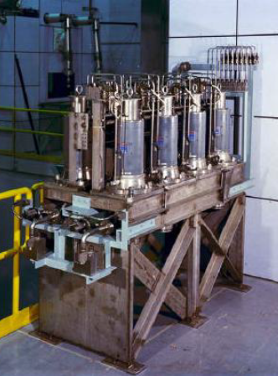
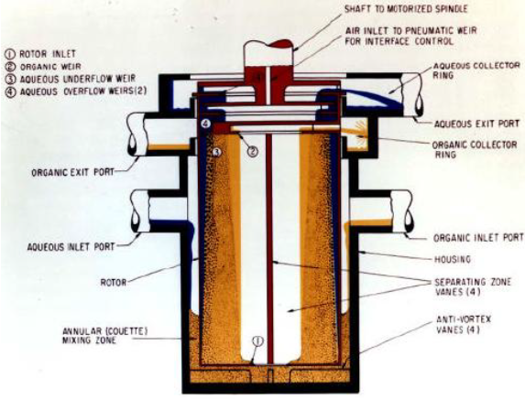
Solvent Extraction Equipment
Centrifugal contactor
Basically a mixer-settler with forced mixing / separation
Must be done repeatedly in sequence, but very compact

Slide 26
Conclusion
“The United States will build the Global Nuclear Energy Partnership to work with other nations to develop and deploy advanced nuclear recycling and reactor technologies. This initiative will provide reliable, emission-free energy with less of the waste burden of older technologies and without making available separated plutonium that could be used by rogue states or terrorists for nuclear weapons. These new technologies will make possible a dramatic expansion of safe, clean nuclear energy to meet the growing global energy demand.”
– (GNEP plan)

Slide 27
Do you understand? Can you explain? Can you estimate?
(1) What are the three major steps along the technical route to a nuclear weapon?
(2) Can you draw / explain how we get Pu isotopes from ²³⁸U?
(3) Do you understand how Pu isotopic ratios change with irradiation time / fuel burnup?
(4) Do you understand why a proliferator wants to limit the time (burnup of) the fuel is in the reactor to gain WGPu?
(5) Why don’t / can’t we use Pu for gun-type weapons?
(6) Why are CANDU reactors a proliferation risk for Pu production?
(7) Can you explain the what, why, and so what of fuel reprocessing?
(8) can you describe the key steps to the PUREX process?

